Slide 1

Enabling federated access to Erasmus+ services
Sunet Webinarium 24 Mars 2021
Agreement number: INEA/CEF/ICT/A20128/1633245 Action No: 2018-EU-IA-0036

Slide 2
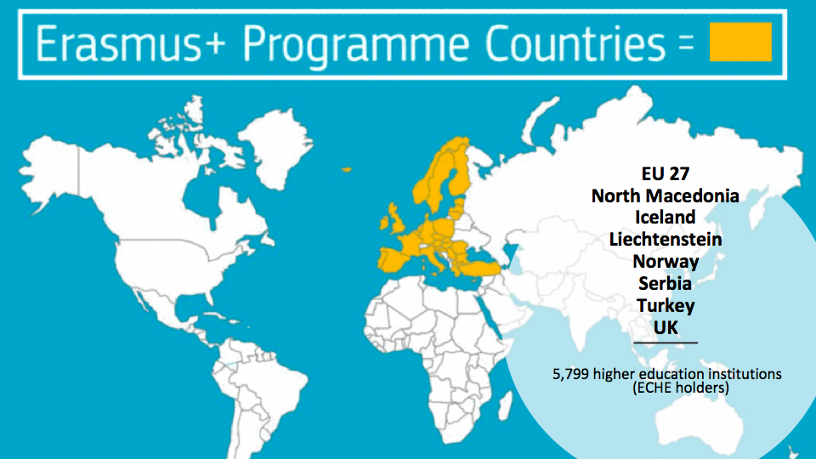

Slide 3
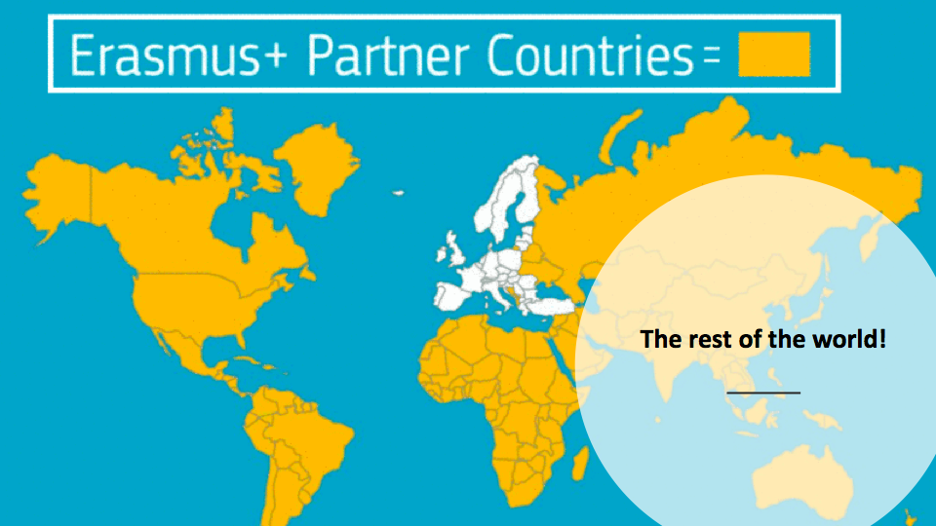
Notes:
Major bottom-up initiatives are underway in the context of the European Commission aimed at digitalising data transaction between Universities.
3

Slide 4
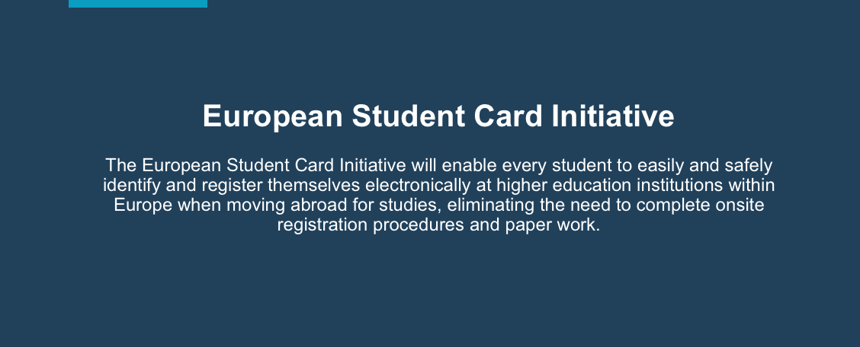
European Student Card Initiative - ESCI
https://ec.europa.eu/education/education-in-the-eu/european-student-card-initiative_en
Notes:
The Erasmus+ is under the umbrella of the ESCI
4

Slide 5

European Student Card Initiative: Goals
Digitalising and streamlining student mobility administration
Rolling out the European Student Card and the European Student Identifier
Notes:
The ECSI will develop one-stop-shop for students to manage all administrative steps related to their mobility period – before, during and after their stay.

Slide 6

Roadmap to paperless mobility
2021 - to manage online learning agreements
2022 - to manage inter-institutional agreements
2023 - to exchange student nominations and acceptances and transcripts of records related to student mobility
Notes:
6

Slide 7

Erasmus+ Programme (DG-EAC)
To digitise procedures and services to support Erasmus students.
New Programme Framework under approval for 2021-2027.
Connecting Europe Facility Projects (DG-CONNECT/CEF)
To develop a core platform and a unique student identifier for students’ online authentication.
Notes:
7

Slide 8
MyAcademicID: Towards an European Student eID
Outlining
Outlining Student Mobility related use cases
Agreeing
Agreeing the way to uniquely identify students when they move from A to B (ESI)
Designing
Designing an architecture to enable a single interface for authenticating students
Building
Building a first bridge with the citizen eID eIDAS and eduGAIN
Implementing
Implementing the authentication interface as defined in the architecture on some of the use cases
https://www.myacademic-id.eu/
Notes:
Here comes christos

Slide 9
Problem Statement
Services for student mobility requires knowing: who wants to access them
and what their home university is
Digital identity to support student mobility to implement the European Student Card Initiative Vision

Slide 10
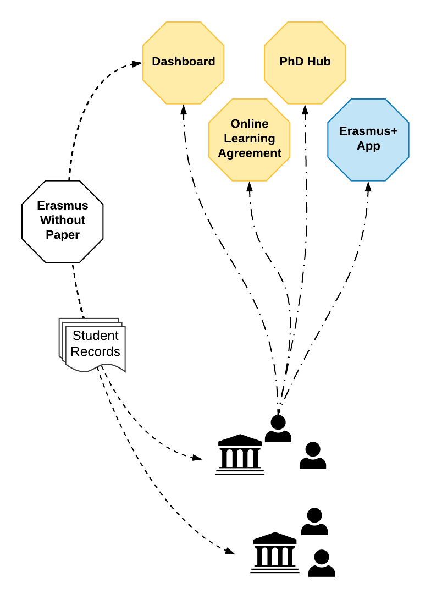
Use-Case

Slide 11
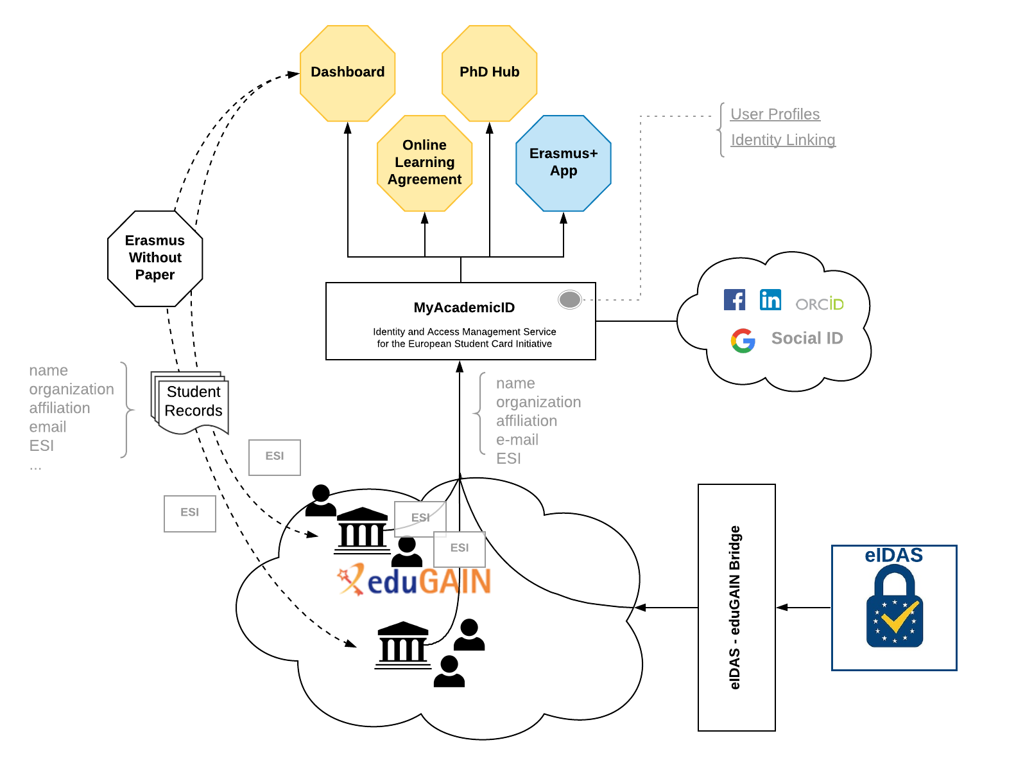
MyAcademicID IAM

Slide 12



Joining forces
eIDAS identifies natural persons
eduGAIN has the ’student’ attribute
Notes:
eduGAIN identifies the relationship between a student and the education/research process
12

Slide 13
~ 5000
Students
May 2020
Consultation with Federation Operators
Sep 2020
The specification for the European Student Identifier is published
Oct 2020
OLA v3 is launched with academic logins enabled; online event with ~2K participants
~600
Institutions
National workshops with HEIs and National Agencies across Europe
Nov 2020
eIDAS logins are enabled through MyAcademicID
Dec 2020
Erasmus+ App enters QA phase
Final MyAcademicID Conference
Jan 2021
Erasmus+ App is launched
Mar 2021
New OLA template comes to effect
Name, email, organization and affiliation is mandatory to access Erasmus services
Aug 2021
ESI is mandatory to access Erasmus services
Notes:
Licia
13

Slide 14


ESCI
ESI
Notes:
All technical work is now in place - How do we make all this accessible to all institutions that participate in Erasmus+ programme ?
Over to christos
14

Slide 15

Next Steps
Erasmus+
8700 Institutions
Work continues in EDSSI project to turn MyAcademicID into the core production platform for student mobility
Connect more Erasmus+ services
How do we make all this accessible to all institutions that participate in Erasmus+ programme ?
5700 in EU
3500 in eudGAIN

Slide 16
Planen i Sverige

Slide 17
Integrationsalternativ
Lärosätet underhåller ESI för varje student och sköter integration direkt med MyAcademicID
Integration med MyAcademicID sker via eduid.se men Lärosätet ansvarar för integration med Ladok och eduid.
Integration med MyAcademicID sker via eduid.se och Sunet genomför integration med Ladok

Slide 18
Sunet erbjuder följande stöd
Egen integration via SWAMID
  SWAMID kommer genomföra informationsinsatser
  Kontakta SWAMID operations - operations@sunet.se
Integration via eduid.se
  Sunet erbjuder integration via eduid.se
  Kontakta fresia@sunet.se så snart som möjligt, dock senast under April 2021

Slide 19


Thank you
https://www.myacademic-id.eu/
Notes:
19

