Slide 1

2018 Roadmap
Confidential

Slide 2

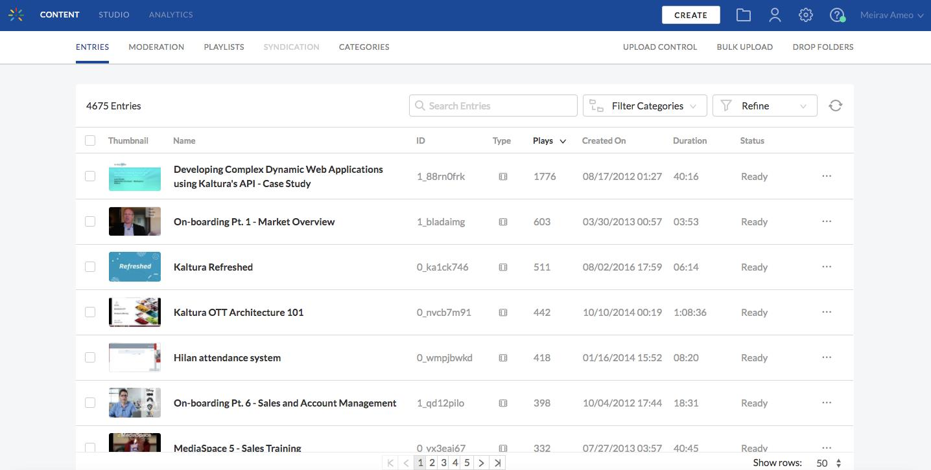
PLATFORM, KMC & PLAYER
2018 Focus Areas
100% HTML KMC
New analytics
Taking REACH workflows in house and extending offering
Editing Tools enhancements
Notes:
H1/2018
Video Editing Tools:
Chop & Splice – Next phase of the new Video Editing Tools. Ability to edit out middle parts of the video . For example, a user recorded a meeting and there was a 25 minute break which the user would like to cut out. Note that it is not meant to be an alternative to professional editing software such as Final CutPro and will not have the same level of granularity and precision (frame by frame) of a professional tool.
100% HTML KMC – The removal of Flash dependency in response to Adobe announcing end of life of Flash in 2020. We are starting with KMC and moving across all products. All existing functionalities will continue to be supported. KMC Flash-free demo is available here: http://kmcng-demonstration.dev.kaltura.com/latest (see notes below)**
Improved Analytics– Building a new infrastructure for Kaltura Analytics based on current big data systems. This will include:
(Near) Real Time VOD Engagement Analytics –Enhancement to current analytics processing times (Currently 24 hours). This ability will allow users to view VOD related analytics almost immediately.
Improved reporting on live and VOD –Expand timeframe to retrieve analytics (currently 36 hours window or lose it).
More granular reporting — More data and more detail. For example, which chapter, full screen. More data points beyond geo-location, syndication, concurrency.
Multiple dimension for data analysis – Important for live and webcasting. Ability to slice the data across multiple dimensions. Currently have the ability to analyze what device is being used the most and where (location).
H2/2018 and Beyond
Media Repurposing – Further enhancements to the ability to specify retention rules for better video storage management or for compliance purposes. Additional rules will be added:
Feedback to content owners (Status message) – Users will receive message that content no longer available or inaccessible when attempting to watch retired media. Content Owners will receive instructions on how to retrieve their video
Rules based on user status – For example, user no longer active employee. Main use case is when employees leave the organization.
Unified transcript widget –Serves customers who do not use Cielo but still want transcripts. It’s a widget that will be found below the player as is currently the case, the unified aspect is the main change as it will allow customers to get transcripts regardless of the source of the captions (Cielo or any other 3rd party provider).

Slide 3

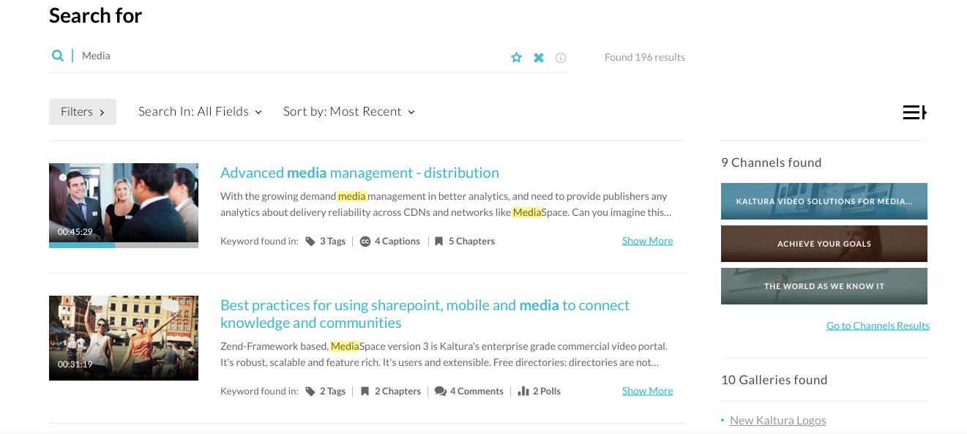
MEDIASPACE
2018 Focus Areas
New Search update
Accessibility – Issue a VPAT
Entitlement enhancements
IVQ enhancements
Personalization
External KMS improvements
Notes:
H1/2018
Search update (available in KMS/KAF only and in upcoming new KMC):
Unified search – No more searching separately in metadata or in captions, with the new search you search one time, for everything. Unified search means that a user can get all the results from all the different objects of the entry in one place. The implication is not only a better UX, but better discoverability as well as the most relevant results across all search categories displayed at the top.
Partial Search – The ability to expand search results based on partial search words. For example, when searching the word ‘media,’ videos containing the word ‘MediaSpace’ will come up as well
Synonyms & Stemming - Synonym based search example, search for ‘media’ brings up results containing ‘video’. Stemming takes the stem of the word and searches for all related words. For example, ’singing’, ’sing’, ’sung’.
More language support – Related to partial search. Some languages especially Asian may not have spacing between words. The addition of partial search, allows us to support search in a larger variety of languages
Accessibility improvements – Finish up & issue VPAT
MediaSpace
In-Video Quiz
CaptureSpace
Player
Video Editing Tools -
Chop & Splice - Ability to edit out middle parts of the video . For example, a user recorded a meeting and there was a 25 minute break which the user would like to cut out. Note that it is not meant to be an alternative to professional editing software such as Final CutPro and will not have the same level of granularity and precision (frame by frame) of a professional tool.
Entitlement Improvement –
Multi-Authentication - Ability to authenticate against more than one system. For example, EDU guest lecturer / ENT vendor whom a customer does not want to add to the User Management system, but sill want to provide access to create and view content, or merger btw companies that use different authentication systems
SAML group sync – Comes up more often in ENT where there is a process of removing an employee who has left the company from all user groups he participated in the identity management system to ensure he/she no longer has access to content. SAML group sync will allow customers to include Kaltura in that removal process. Currently needs to be done separately.
Group management - The ability to carry over group classifications from the User Management system into MediaSpace. This will allow to more easily create groups within the KMS as well as better workflows. For example, assigning a group as co-publishers instead of doing one by one or assigning a group as channel members. Group size will be limited.
IVQ - 1.2 –
More question types - true/false, reflection point
Force progressive viewing – mandates viewers to watch the entire video bc it prevents the ability to ‘seek forward’ (but still allows to ‘seek back’)
Retake Quiz – Phase 1 – currently once quiz has been submitted, there is no retake option. Phase 1: Quiz owner will be able to erase a user’s results thereby allowing the use to retake the quiz. This configuration caters mainly to specific, individual cases.
REACH - Improve Caption Ordering & Moderation Flows – Related primarily to billing. By taking REACH in-house we will have the ability to measure things better, improve operational costs and workflows
Personalization – Creating a more personalized and specific experience for end-users. Next focus area: My playlists
H2 2018 and Beyond
Video Editing Tools – We continue to explore additional improvements focusing on lite editing and overlays. Specific additional capabilities still TBD
Personalization – Continued work on creating a more personalized and specific experience for end-users. Next; Watch later, My profile, My quiz, My favorites
IVQ 1.3–
multiple choice with multiple correct answers,
Anonymous quiz use. Can be applied for either internal or external use cases. For example, a feedback form (survey) or to increase engagement of marketing content.
Several question on same cue point – Expands current IVQ capabilities (Note: along with upcoming capability to support anonymous users, allows for creation of feedback forms/surveys)
REACH
Department level moderation & reports – better moderation capabilities and improved reporting
Per Channel Look & Feel Configuration – Ability to customize the look & feel of each channel, including setting up specific player per channel. This is useful for branding channels per department / school / line of business / brand.
External KMS improvements –
Channel embedding (Related to marketing workflow optimization)
Player in homepage option (Provides additional option on homepage. For example, CTA option within homepage, not just carousel)
Self & Social Registration (i.e. make anonymous users known)

Slide 4
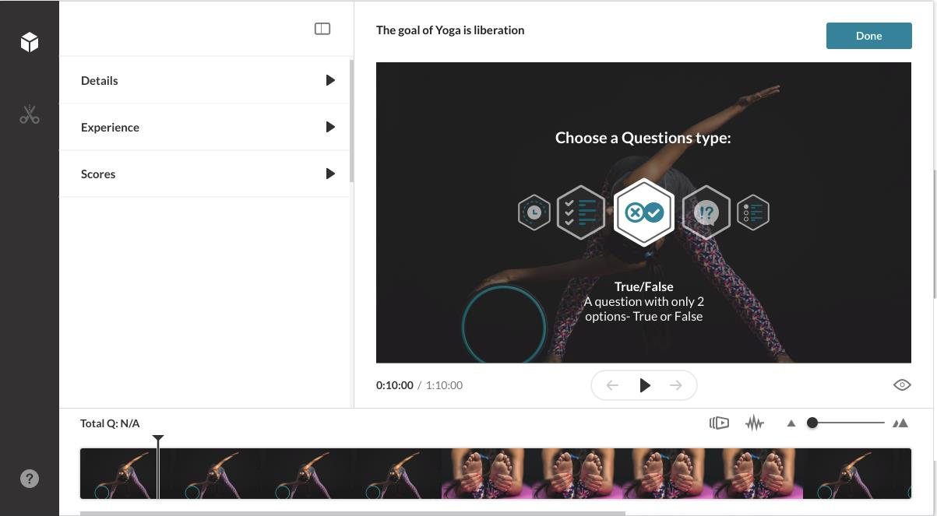
LMS INTEGRATIONS
2018 Focus Areas
New Search update
Accessibility – Issue a VPAT
IVQ enhancements
Personalization
LMS <-> KMS interoperability improvements
Improved BSE
Notes:
H1/2018
Accessibility Improvements – Finish up & issue VPAT
MediaSpace
In-Video Quiz
CaptureSpace
Player
Video Editing Tools – See notes from previous slide
Chop & Splice
Search Update – See notes from previous slide
LMS –
Note: Sakai 11 (not Sakai 12) - grade book integration, responsive player
Rich text editor —Improvements to UX in two areas:
Ability to create content directly from BSE (Browse, Search, Embed) with less clicks and windows
More advanced options when choosing embed type e.g. player with transcripts, but only for entries that have transcripts or audio player
IVQ 1.2 – See notes from previous slide
More question types - true/false, reflection point
Force progressive viewing – ability to prevent ‘seek forward’ and ensure viewers do not skip segments of the video (Note that ‘seek back’ is allowed)
Retake Quiz – Phase 1 – Phase 1 will focus on providing quiz owners the ability to erase quiz results for individuals so that the they can retake the quiz. Note: this will be a manual process suitable for specific, individual cases
Personalization – my quizzes
H2/2018 and Beyond
LMS
Note: BB Ultra — Working with BB to ensure all APIs are in place so we can move this integration forward
LMS - KMS - Interoperability - Better interoperability beyond MyMedia for customers using both. Looking at options such as: shared repository between the different applications, ability to see if video is in one application while in the other.
Personalization – Continued work on creating a more personalized and specific experience for end-users. Next: My Quizzes
Publish plugin- Kaltura currently logs up to 200 courses i.e. 001-200. This pertains to the ability to publish to more than 200 courses from MyMedia and to the ability to view and publish to Course ID higher than 200.
Multiple shared repositories – shared repositories per departments. Might be depended on customer having KMS or might be possible only for specific LMS where department level information is available
Playlist Workflows –Use playlists in a more expansive way; Have the ability to manage your playlists inside the LMS and be able to embed using BSE
IVQ 1.3 –
Multiple choice with multiple correct answers,
Anonymous quiz use. Can be applied for either internal or external use cases. For example, a feedback form or to increase engagement of marketing content.
Several question on cue point – Together with the above capability provides support for use cases that require feedback forms/surveys

Slide 5

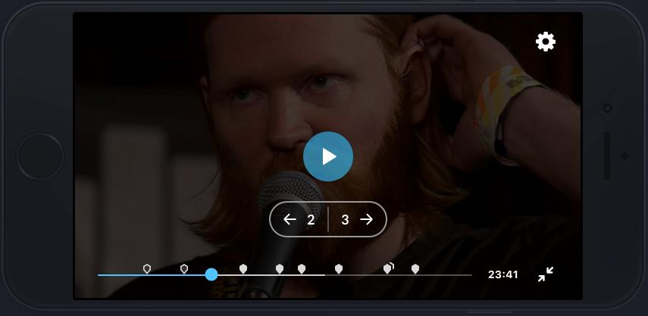
KMS GO (MOBILE APPLICATIONS)
2018 Focus Areas
Interactivity & engagement features
Personalization
Accessibility
Podcast workflows
Notes:
H1/2018
Live playback
Interactivity & Engagement:
IVQ
Slides & chapters
Resume playback – extension of KMS feature
My history – extension of KMS feature
Localization support
Multi authentication – Use case: guest lecture that is not part of an institution’s directory
H2/2018 and Beyond
Interactivity, engagement
Q&A
Polls
New Search – extension of KMS capabilities (partial, synonym etc.)
Accessibility
Watch later – extension of KMS features
Push notifications – Ability to stay connected and get notifications wherever you are
Podcast workflows – Audio playlist display, player that shows only audio, ability to download for offline listening

Slide 6

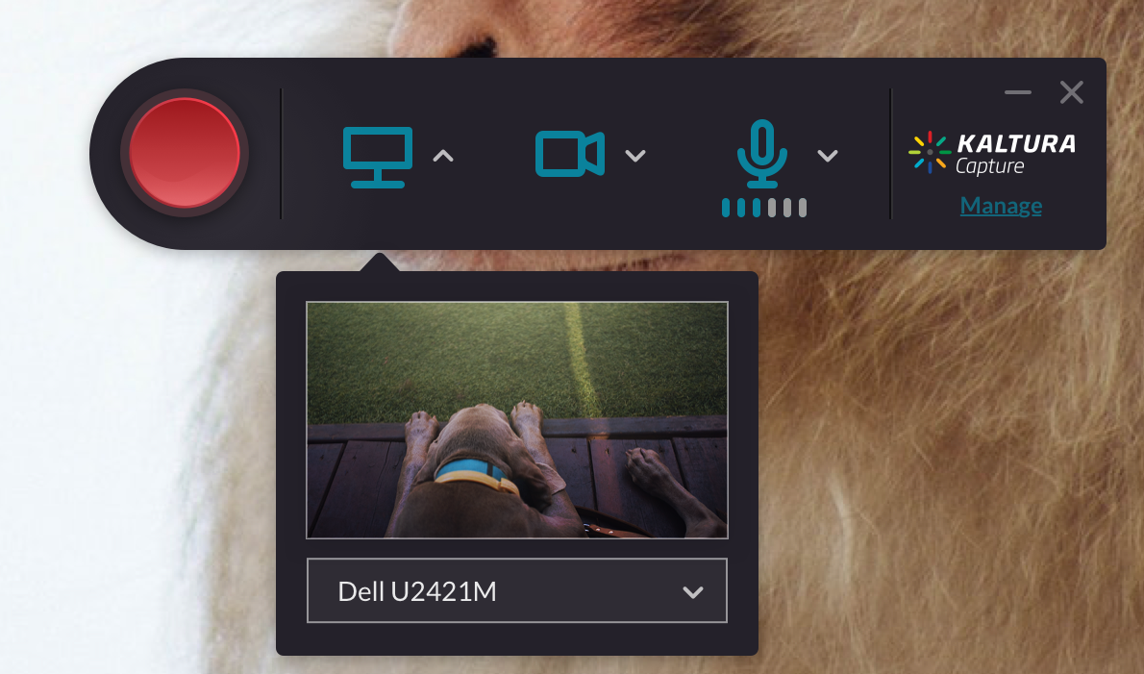
KALTURA CAPTURE SUITE
2018 Focus Areas
New personal capture tools supporting enterprise deployment scenarios
Kaltura Classroom for lecture capture workflows
Easier creation options via mobile and browser
Rich video experiences for creators and viewers
Notes:
H1/2018
Classroom
Accessibility – see previous slides
Sorting/ filtering on monitoring dashboard – for easy management of multiple classroom captures happening simultaneously.
Smart alerts – additional enhancements that focus on easier management of individual classroom captures
Monitor audio input from dashboard – see comment above
H2/2018
Classroom
Live broadcasts of lectures
Usage reports – specific to LC content and based on Kaltura’s upcoming new analytics.
Publishing for ad hoc recordings – create similar workflow to the one for scheduled recording
Enable control of the recording from the Crestron in the classroom
Improved scheduling – blackout dates, weekly/daily views, sorting/filtering.
Engagement tools – TBD but currently considering things such as polls.
Personal Capture
New tools to create interactive content – Teleprompter, controlled views, annotation tools
CaptureSpace as you know is an OEMed product. Since that is such a crucial capability we are taking it in house. CaptureSpace and CaptureSpace Lite will continue to be supported for a long time.

Slide 7
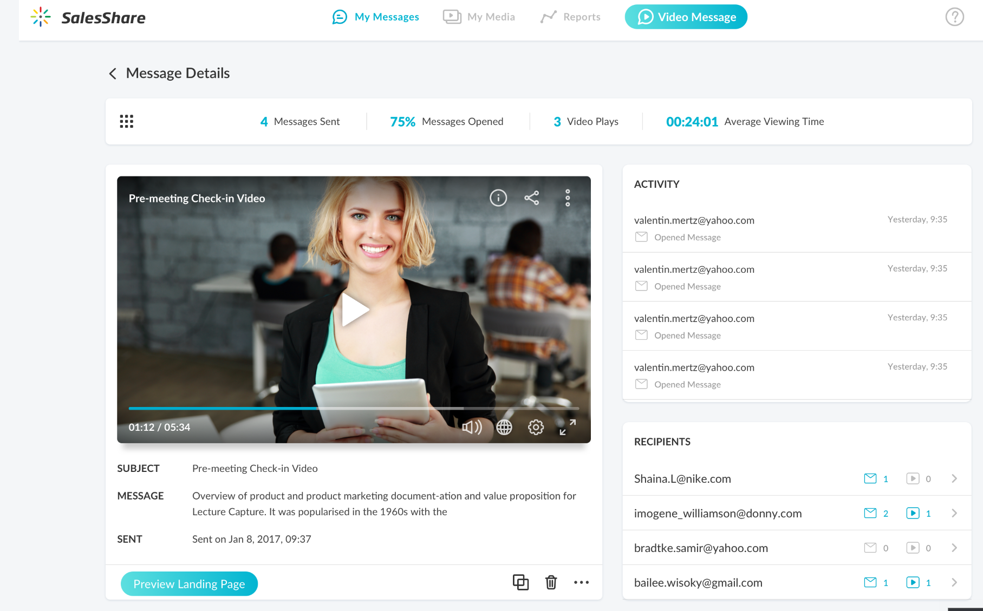
VIDEO FOR SALES
2018 Focus Areas
Mobile & web creation of personalized video
Customizable landing pages and emails
Tracking and analytics
Integrated with CRM, marketing automation platforms, prospecting tools
Marketing material integration into message creation

Slide 8

THANK YOU!

