Slide 1



Kaltura - NORDUnet
Upcoming new products and features
Confidential

Slide 2

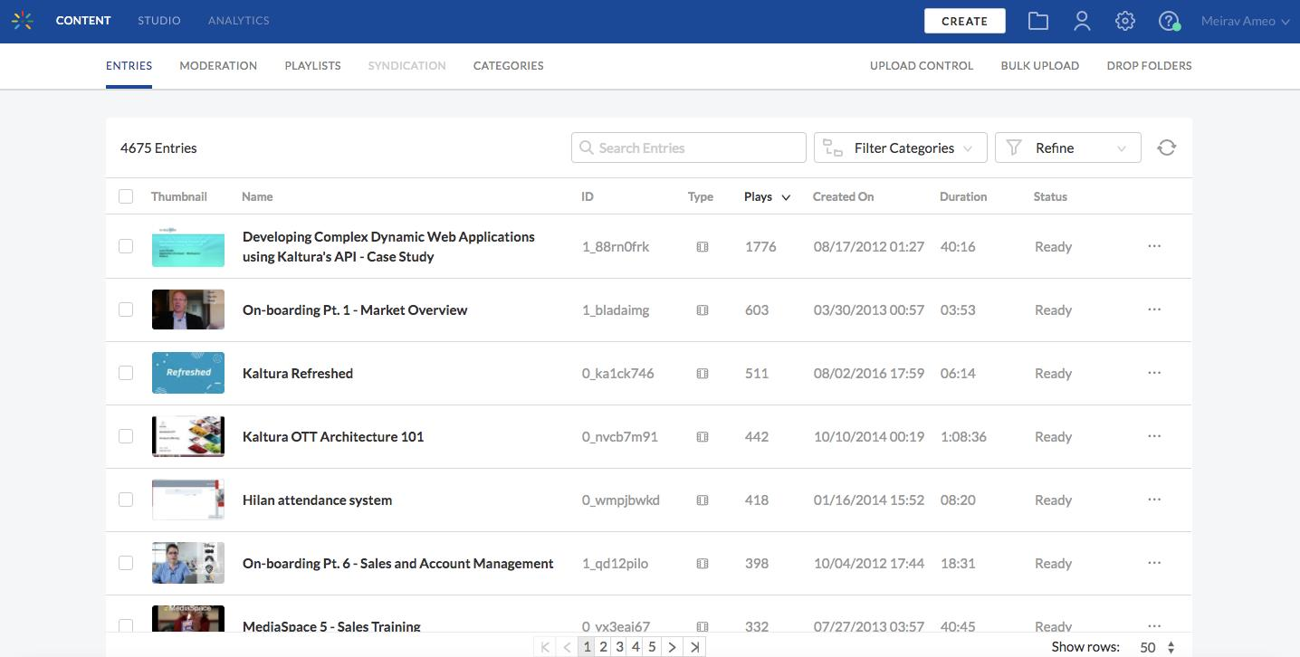
PLATFORM, KMC & PLAYER
2018 Focus Areas
100% HTML KMC
New analytics
Taking REACH workflows in house and extending offering
Editing Tools enhancements
Notes:
H1/2018
Video Editing Tools:
Chop & Splice – Next phase of the new Video Editing Tools. Ability to edit out middle parts of the video . For example, a user recorded a meeting and there was a 25 minute break which the user would like to cut out. Note that it is not meant to be an alternative to professional editing software such as Final CutPro and will not have the same level of granularity and precision (frame by frame) of a professional tool.
100% HTML KMC – The removal of Flash dependency in response to Adobe announcing end of life of Flash in 2020. We are starting with KMC and moving across all products. All existing functionalities will continue to be supported. KMC Flash-free demo is available here: http://kmcng-demonstration.dev.kaltura.com/latest (see notes below)**
Improved Analytics– Building a new infrastructure for Kaltura Analytics based on current big data systems. This will include:
(Near) Real Time VOD Engagement Analytics –Enhancement to current analytics processing times (Currently 24 hours). This ability will allow users to view VOD related analytics almost immediately.
Improved reporting on live and VOD –Expand timeframe to retrieve analytics (currently 36 hours window or lose it).
More granular reporting — More data and more detail. For example, which chapter, full screen. More data points beyond geo-location, syndication, concurrency.
Multiple dimension for data analysis – Important for live and webcasting. Ability to slice the data across multiple dimensions. Currently have the ability to analyze what device is being used the most and where (location).
H2/2018 and Beyond
Media Repurposing – Further enhancements to the ability to specify retention rules for better video storage management or for compliance purposes. Additional rules will be added:
Feedback to content owners (Status message) – Users will receive message that content no longer available or inaccessible when attempting to watch retired media. Content Owners will receive instructions on how to retrieve their video
Rules based on user status – For example, user no longer active employee. Main use case is when employees leave the organization.
Unified transcript widget –Serves customers who do not use Cielo but still want transcripts. It’s a widget that will be found below the player as is currently the case, the unified aspect is the main change as it will allow customers to get transcripts regardless of the source of the captions (Cielo or any other 3rd party provider).

Slide 3

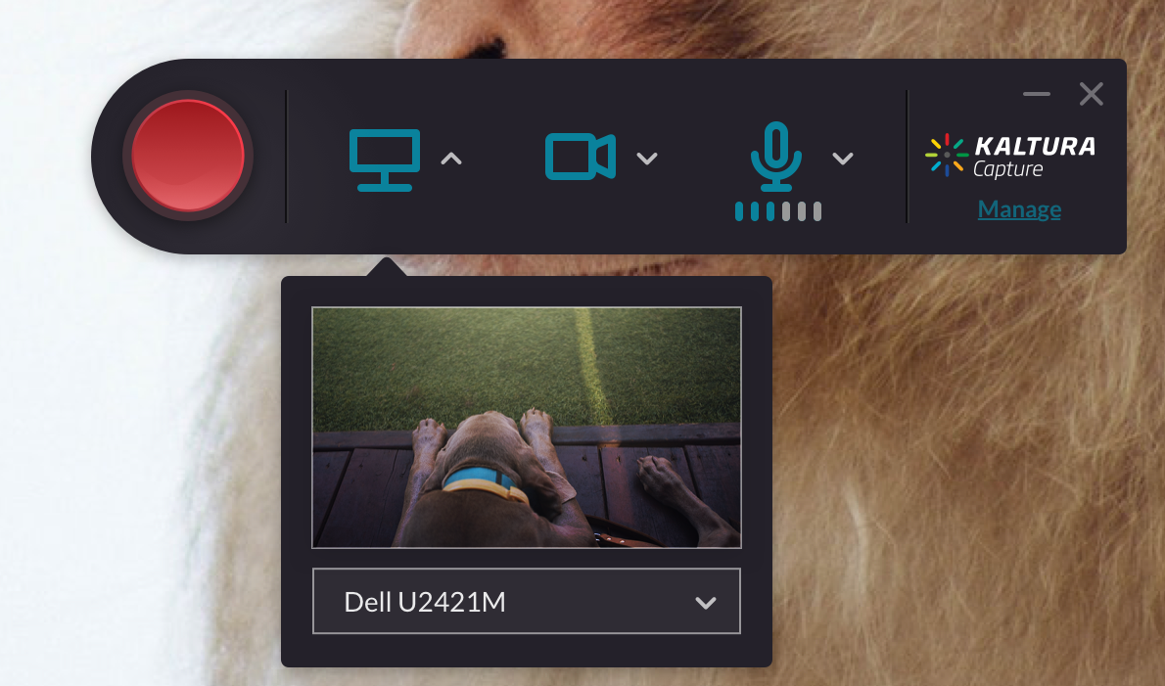
KALTURA CAPTURE SUITE
2018 Focus Areas
New personal capture tools supporting enterprise deployment scenarios
Kaltura Classroom for lecture capture workflows
Easier creation options via mobile and browser
Rich video experiences for creators and viewers
Notes:
H1/2018
Classroom
Accessibility – see previous slides
Sorting/ filtering on monitoring dashboard – for easy management of multiple classroom captures happening simultaneously.
Smart alerts – additional enhancements that focus on easier management of individual classroom captures
Monitor audio input from dashboard – see comment above
H2/2018
Classroom
Live broadcasts of lectures
Usage reports – specific to LC content and based on Kaltura’s upcoming new analytics.
Publishing for ad hoc recordings – create similar workflow to the one for scheduled recording
Enable control of the recording from the Crestron in the classroom
Improved scheduling – blackout dates, weekly/daily views, sorting/filtering.
Engagement tools – TBD but currently considering things such as polls.
Personal Capture
New tools to create interactive content – Teleprompter, controlled views, annotation tools
CaptureSpace as you know is an OEMed product. Since that is such a crucial capability we are taking it in house. CaptureSpace and CaptureSpace Lite will continue to be supported for a long time.

Slide 4
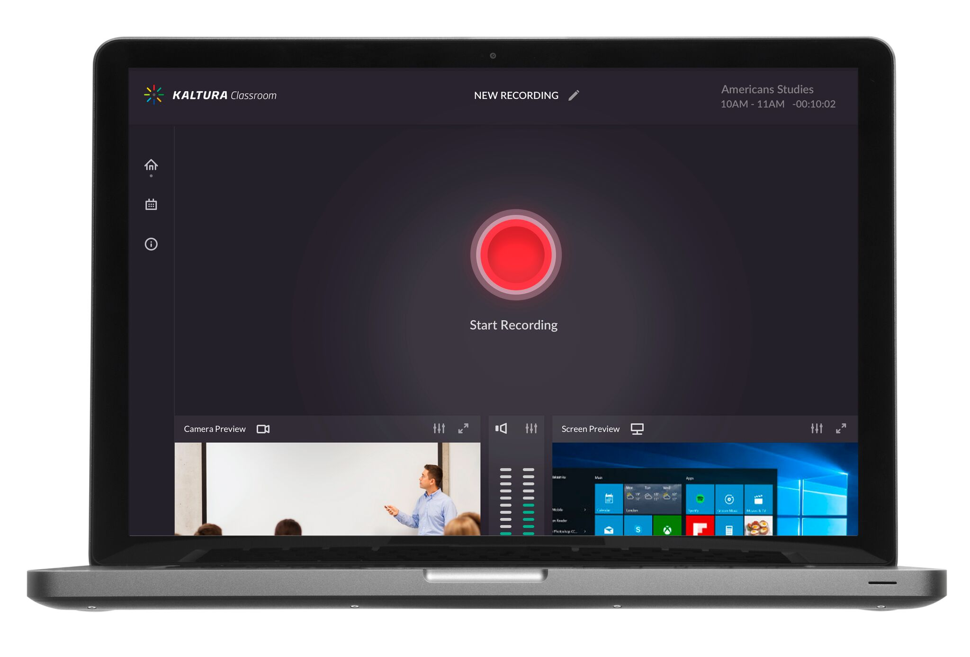
Classroom Capture
High quality recording of screen and camera
Support for software management systems and managed upgrade
Intuitive user interface
Background upload
Automated recording schedule
Automated publishing to LMS courses / channels
System audio recording

Slide 5
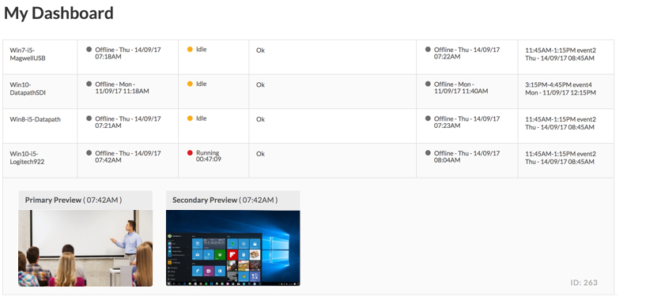
Classroom Capture
Monitoring Dashboard
Slide Capture
Support for Bring Your Own Device
Extend a scheduled recording

Slide 6
THANK YOU!

