Slide 1


Slide 2





Increased transparency in the Nordics
(How is the weather)
Jonas Hagström @ SUNET

Slide 3
Background
WP1 Monitoring
WP2 Weathermap
Increase collaboration
Improved transparency between NOCs
Seek common ground for statistics and monitoring
Notes:
Collaboration between the nordic NRENS SUNET,FUNET,SIKT,DEIC,NORDUnet, (RHNET)

Slide 4
Design
Poller
Poller
Poller
Poller
Poller
DB
FUNET
DB
SUNET
DB
DEIC
DB
SIKT
DB
NORDUnet
DB – NORDUnet (shared instance)
Presentation
Notes:
To be able to swap out different pieces if necessary.
Change polling methods over time perhaps go from SNMP to API-calls to Streaming
Possibility to change DB in the future to something else
Change graphical layer without having to change the complete system.

Slide 5



Polling
Collection
Streaming
SSH
NREN DB
Notes:
LibreNMS - SNMP
Telegraf – SNMP/GNMI
Script – SSH
Vendor agnostic/vendor independent/customized
RFC 2863 - The Interfaces Group MIB
IfAdminStatus and IfOperStatus
https://datatracker.ietf.org/doc/html/rfc2863#section-3.1.13
IN THIS SLIDE ADD DIFFERENT BOXES FOR EACH POLL
ADD SSH & GNMI
Explain GNMI

Slide 6
Database & Data replication
SIKT
SUNET
FUNET
DEIC
NORDUnet
InfluxDB version 2 with bucket replication
Notes:
Each NREN collects data and stores it in influxDB
Each responsible for the own filtering and selection of data to be pushed
The Pushing data from each NREN to shared platform at NORDUnet
Each nren has write (and read) to their own bucket and read to others data
InfluxDB is setup with remote and then replication on bucket level (duplicates all writes to a certain bucket to a remote)

Slide 7
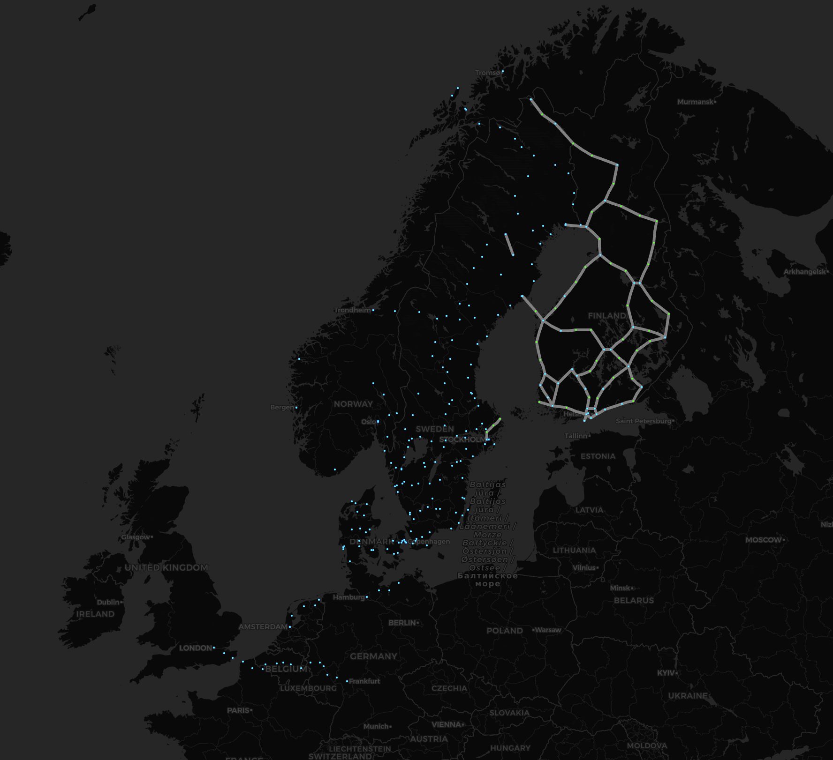
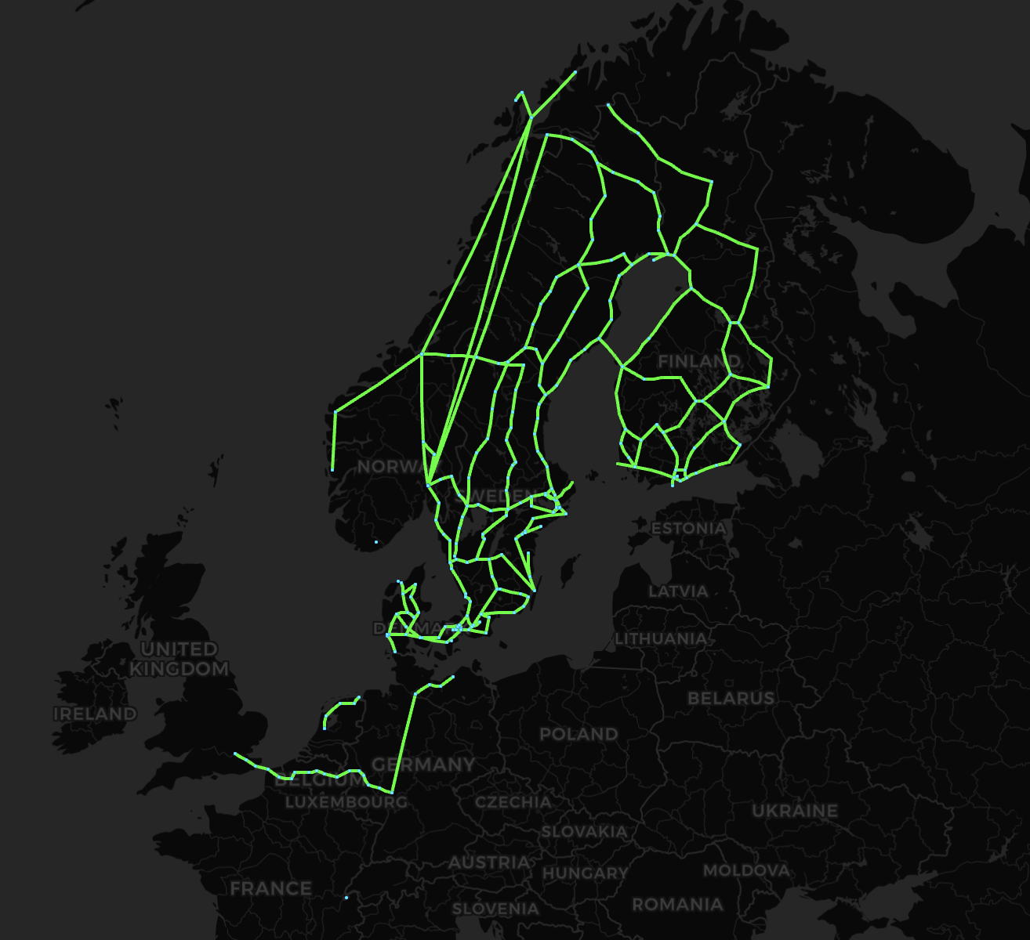
Notes:
Continued development of the map from FUNET
Originally developed for network traffic https://netmap.funet.fi/
Data for configuring the map has been provided from each NREN Sites and Links
Links changes status depending on operational status.

Slide 8
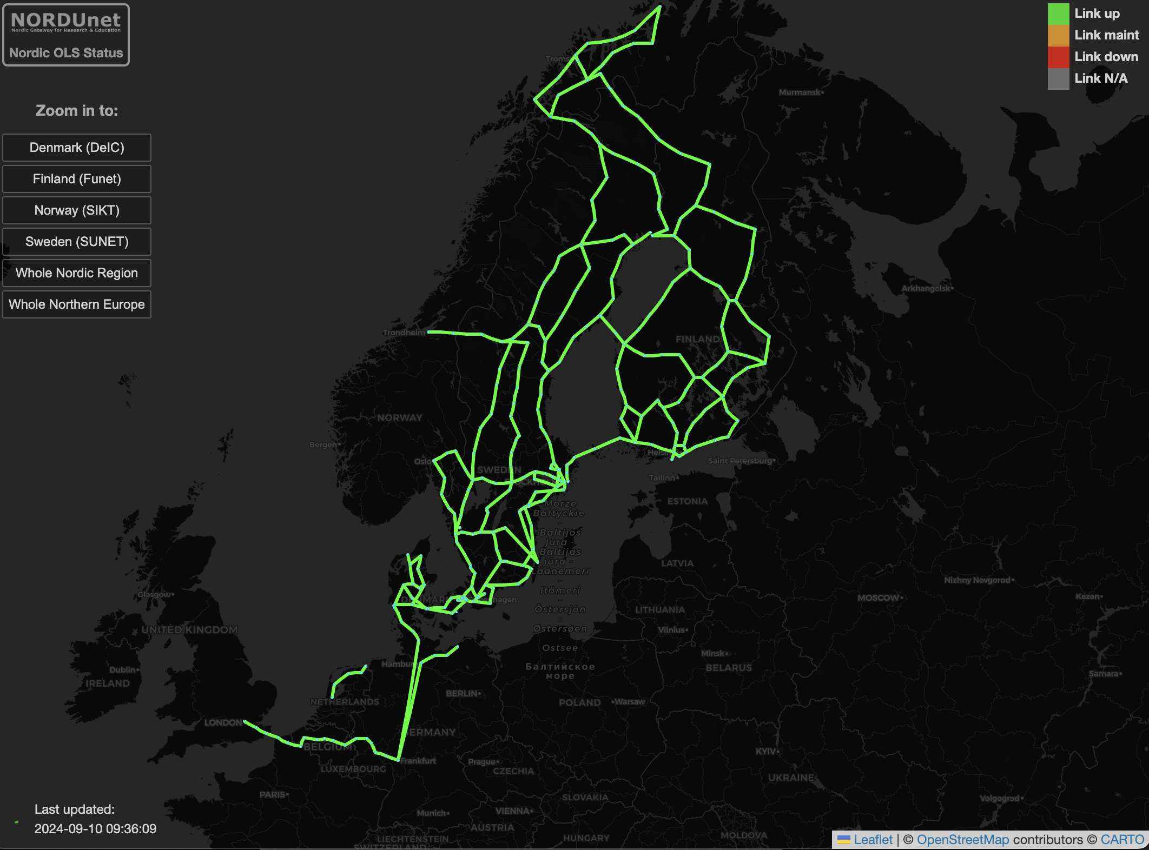
Links from:
SIKT
SUNET
FUNET
DEIC
NORDUnet
Vendors
Ciena
Adva
ECI (Ribbon)
Nokia
~280 Nodes
>300 Links
Notes:
LeaftletJS
PearlCGI
Continued development of the map from FUNET
Originally developed for network traffic https://netmap.funet.fi/
Nordic optical weathermap
Data for configuring the map has been provided from each NREN Sites and Links

Slide 9
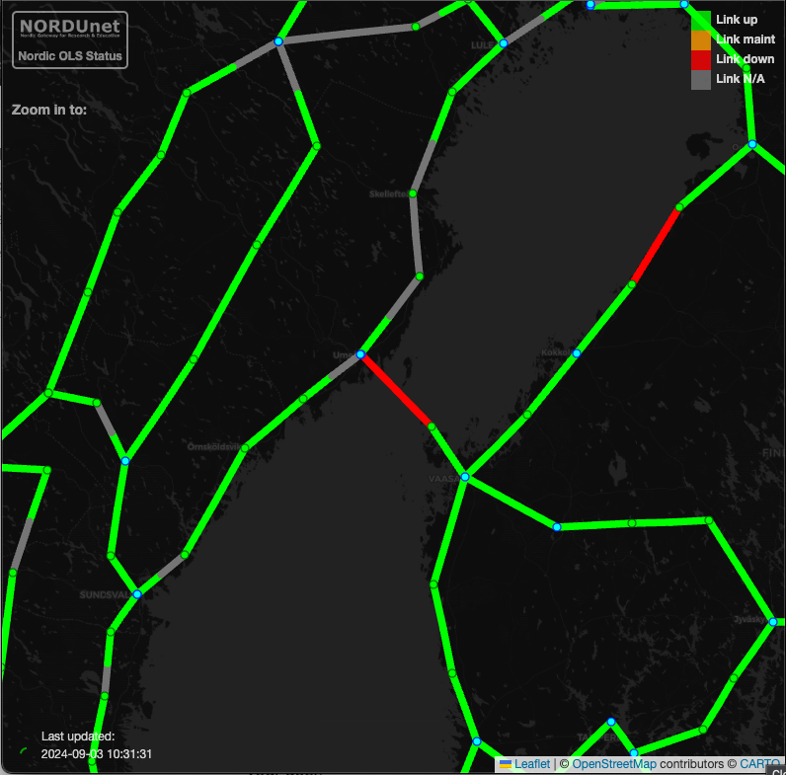
Example

Slide 10
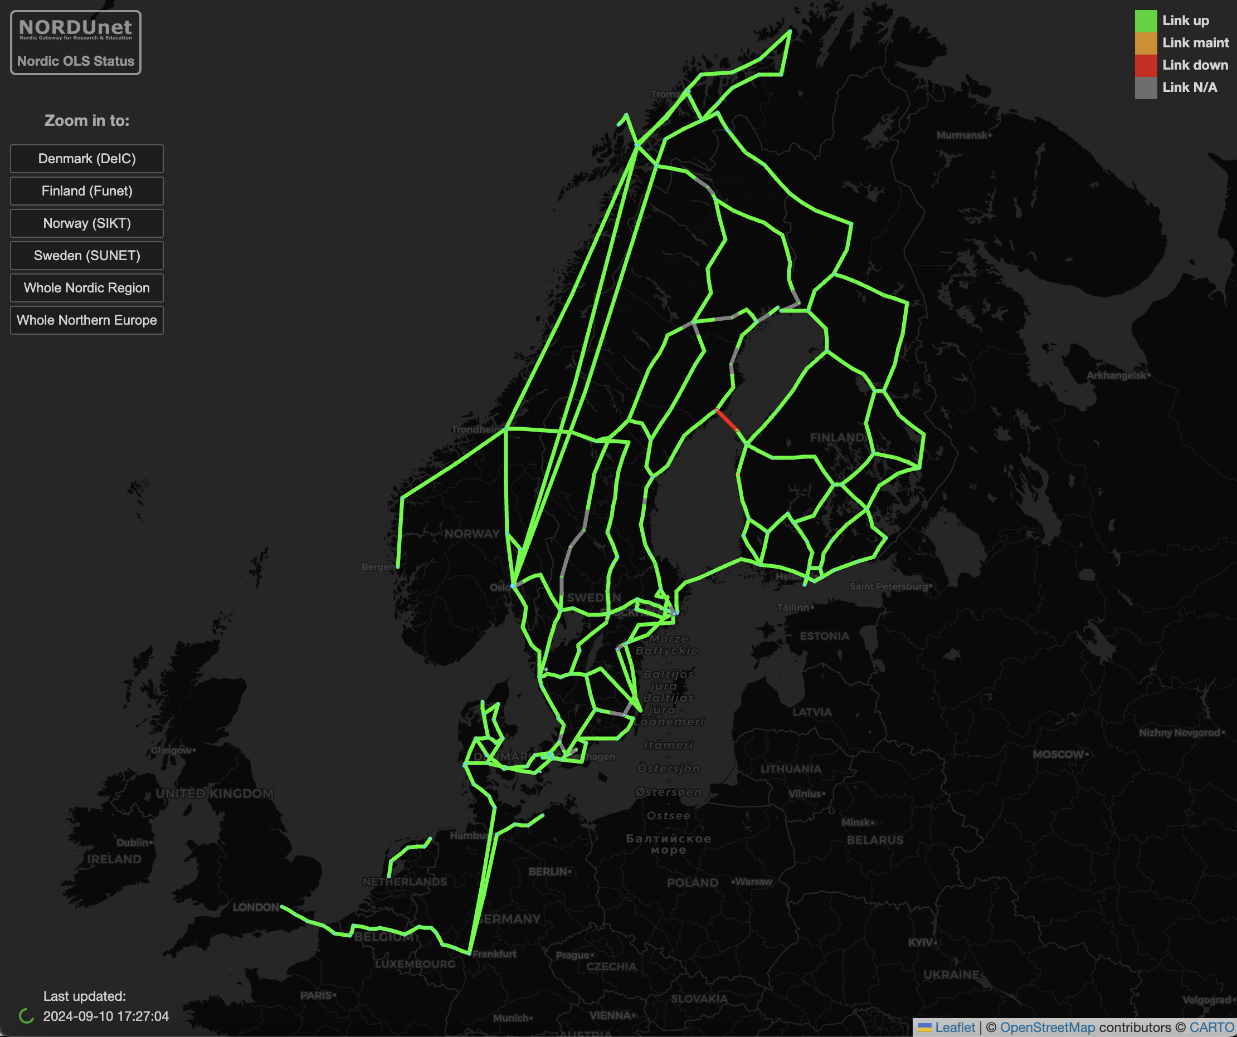
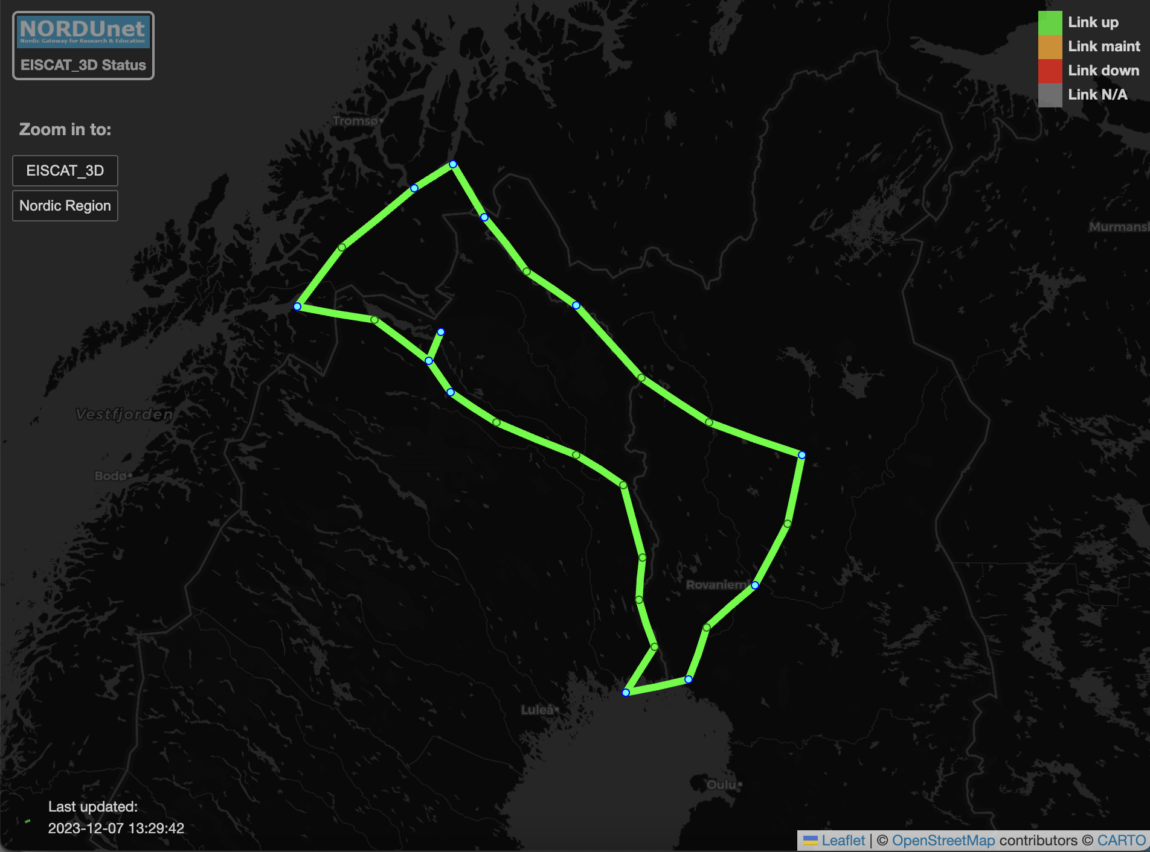
Layers

Slide 11
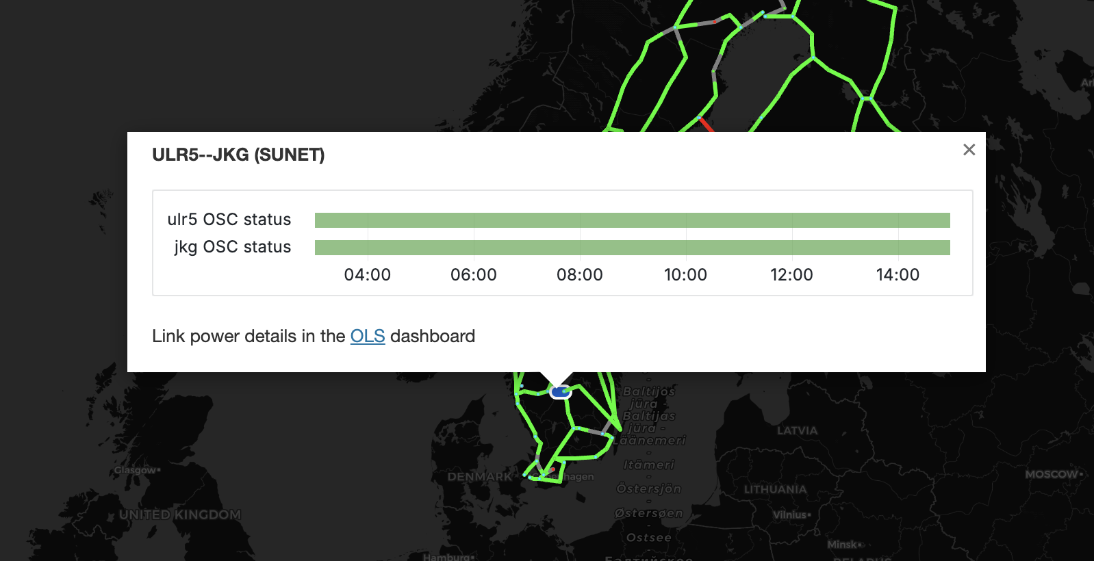
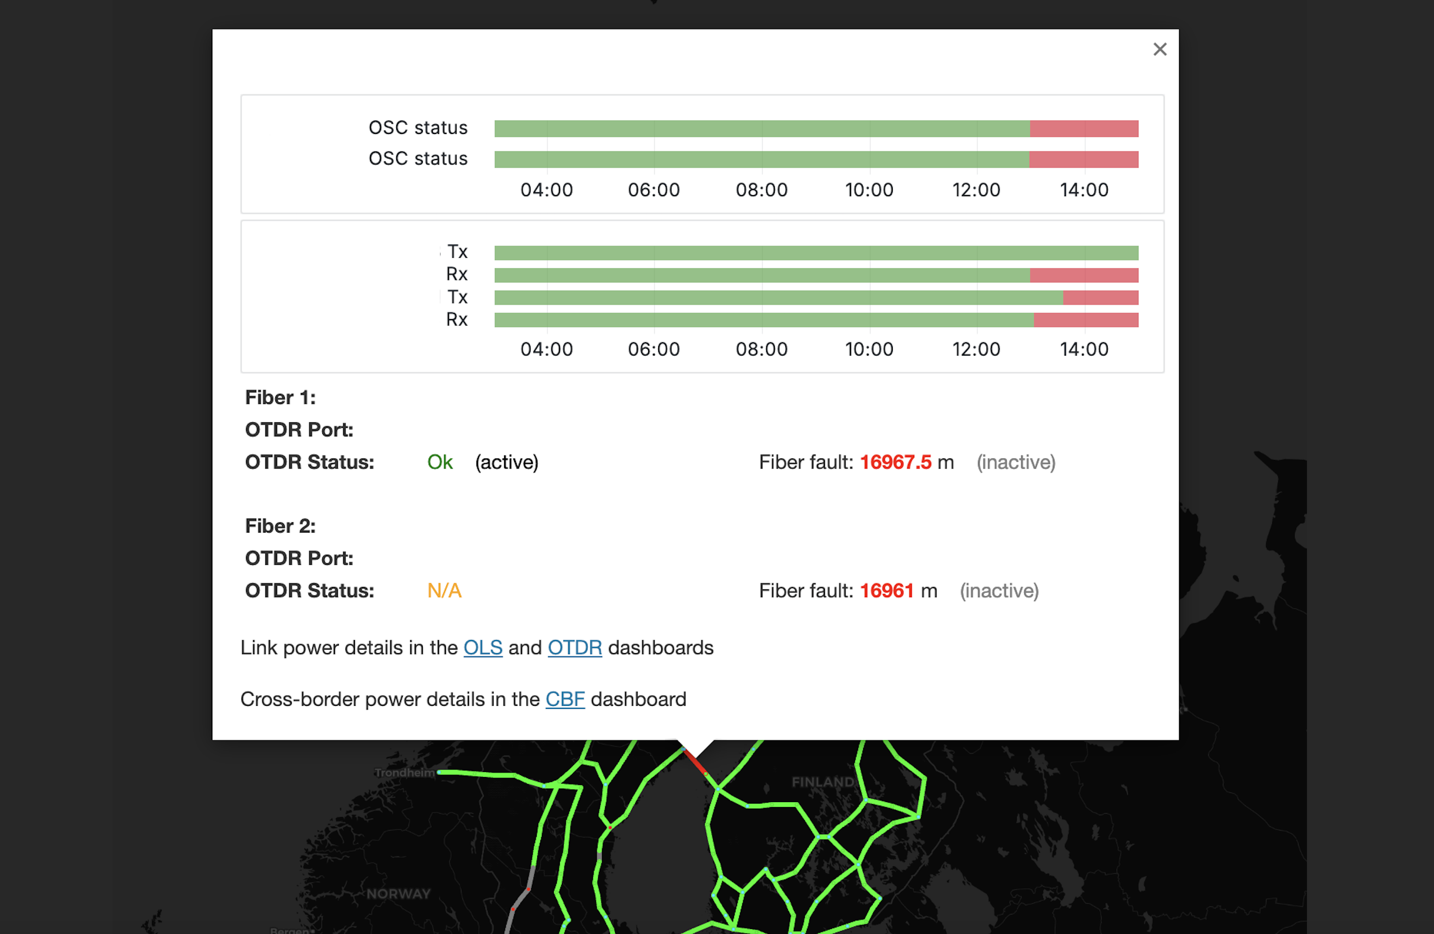
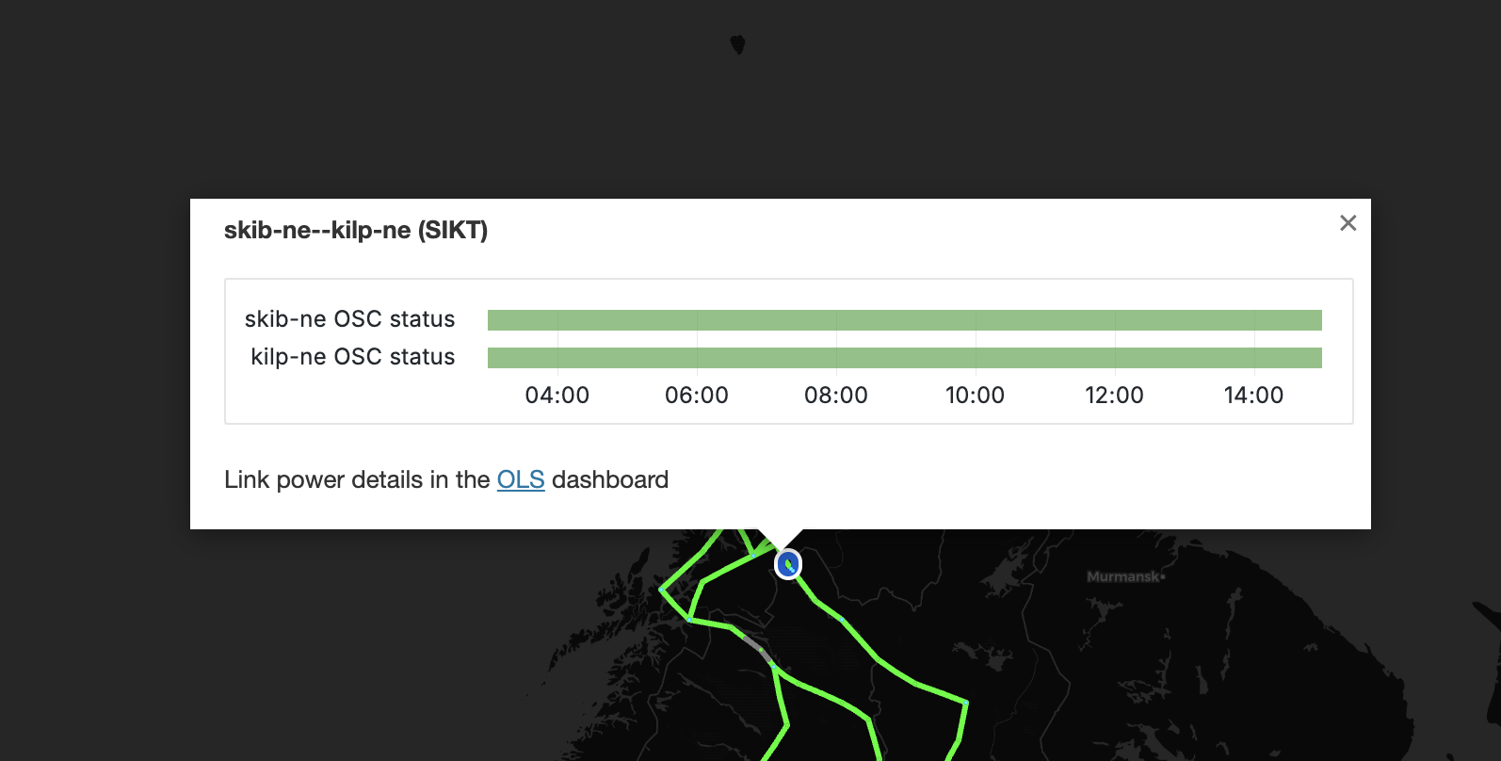

Slide 12
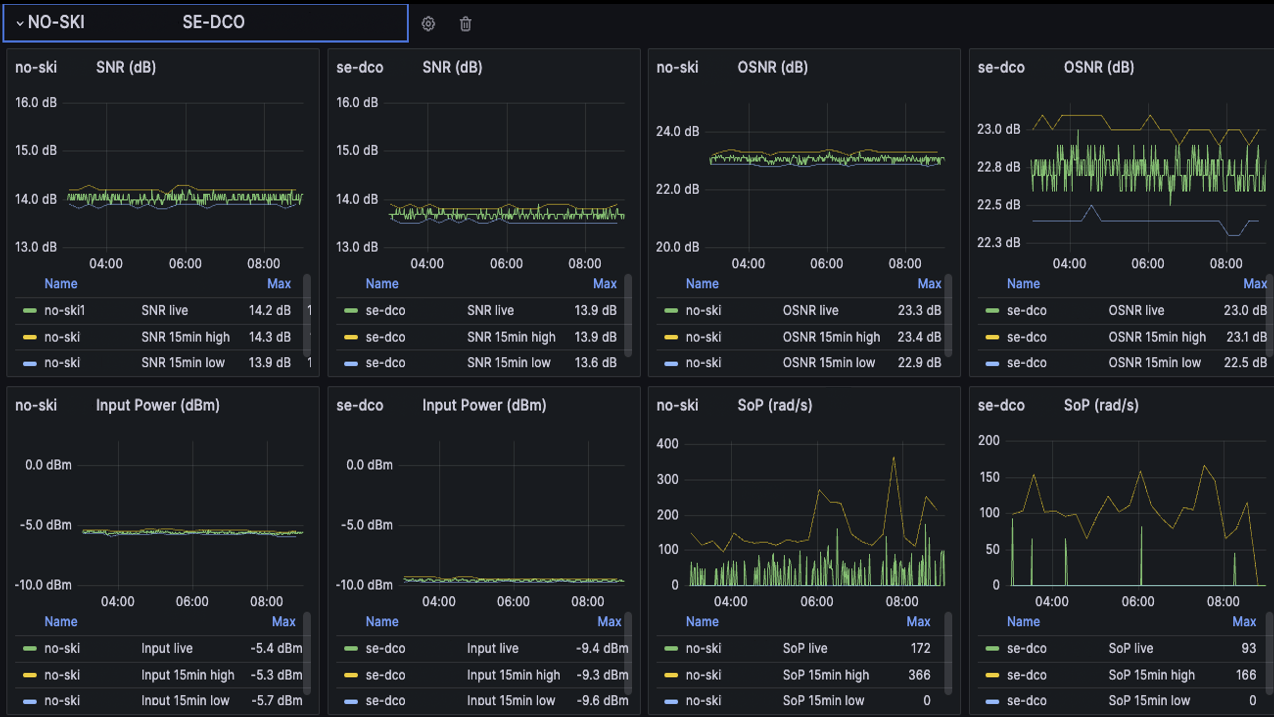
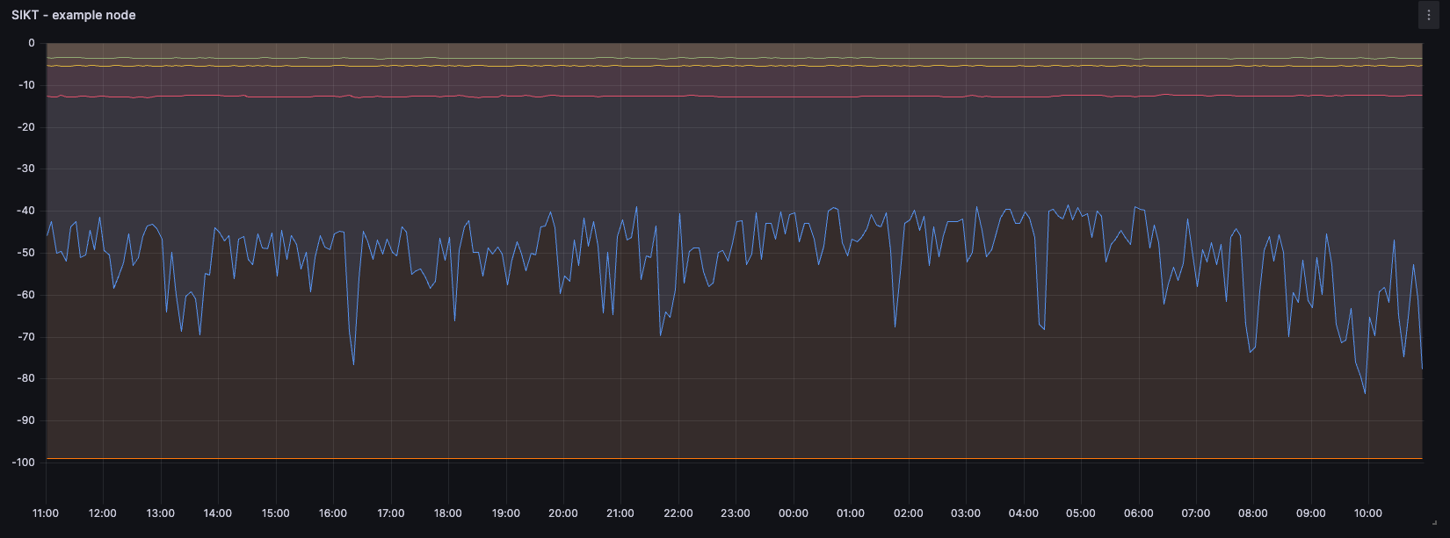

Slide 13
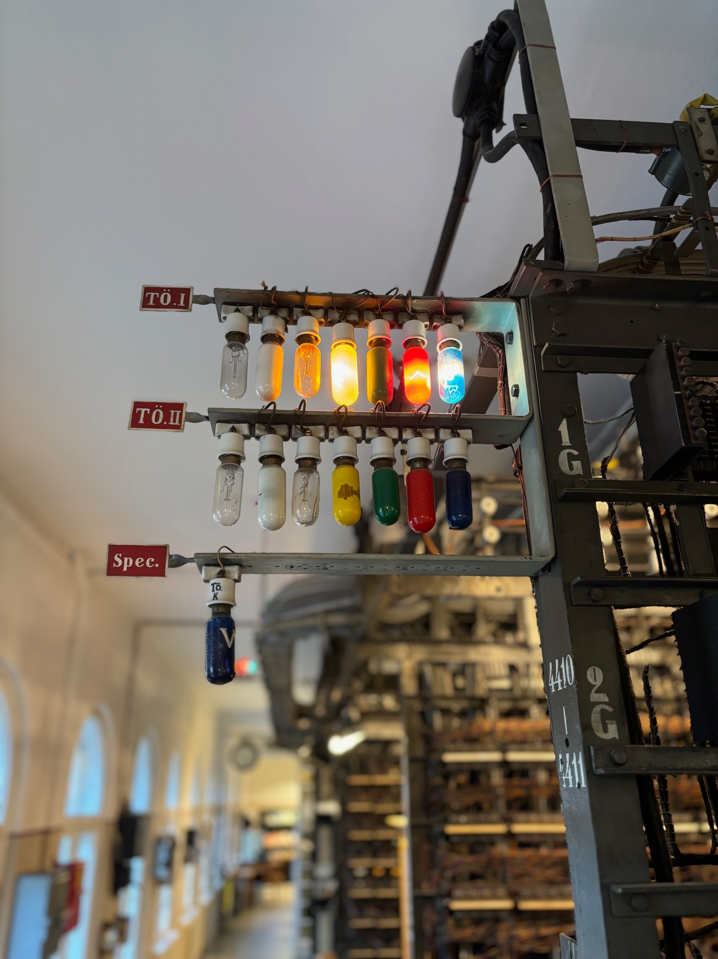
Notes:
You could say we built another lightbulb system
This image from Telephone Museum in Finland

Slide 14
Frågor?

